Slide 1
RockMonitor XR
Notes:
This is a presentation on the RockMonitor real time strata monitoring system.

Slide 2
CONTENTS
Introduction
Limitations of Manual Inspections
Remote Strata Monitoring
RockMonitor XR – System Details
Application Software
Independent Studies
What’s Coming Next
Notes:
So today we will go through the following.

Slide 3
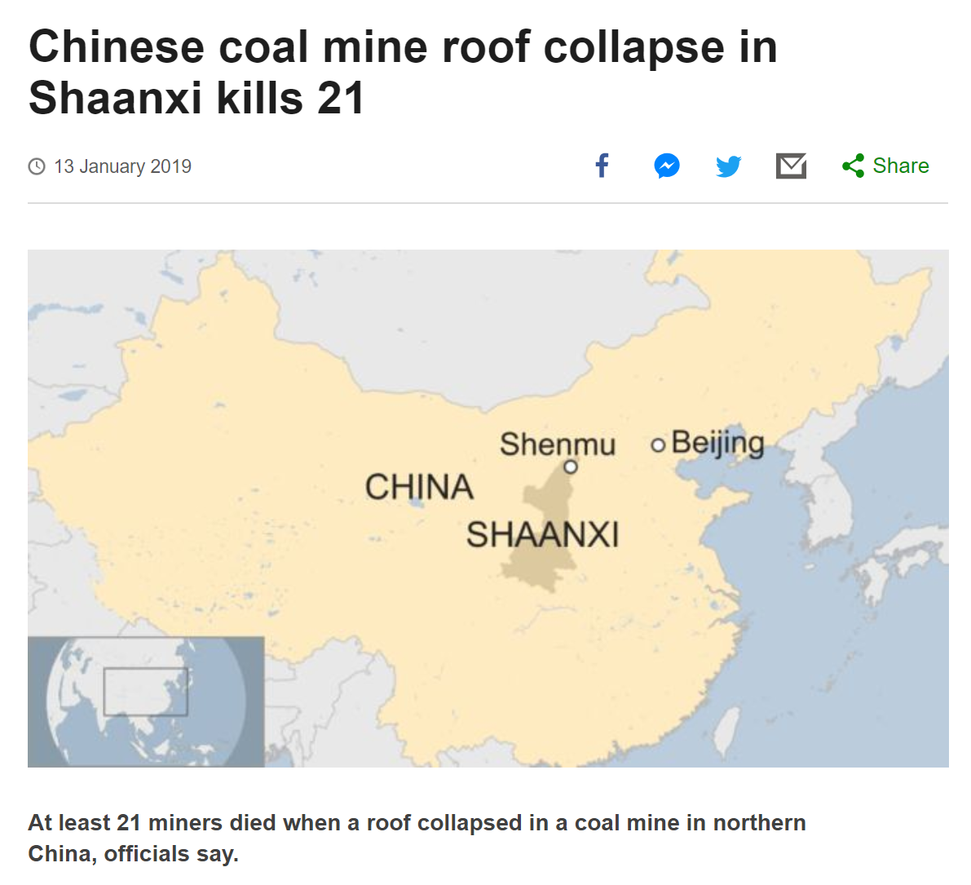
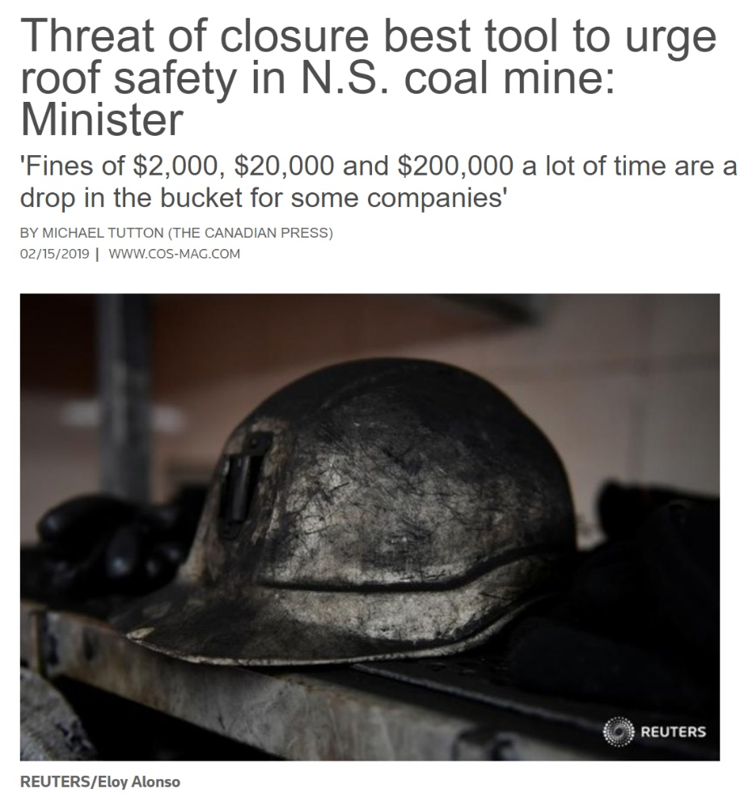
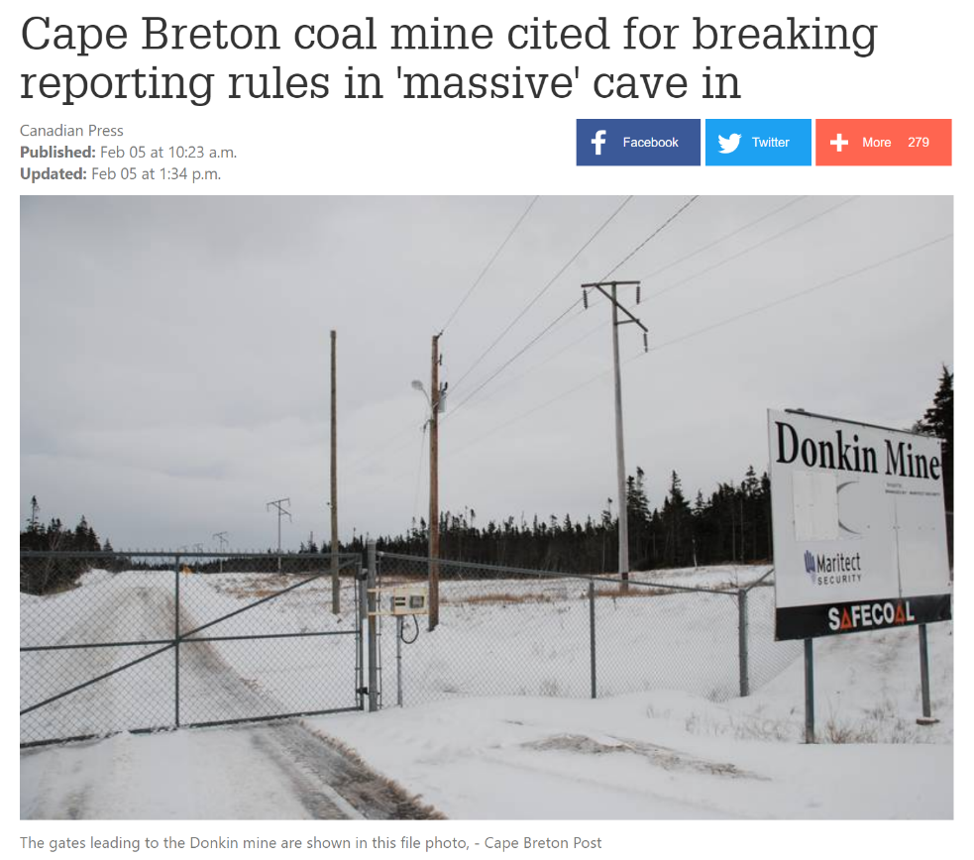
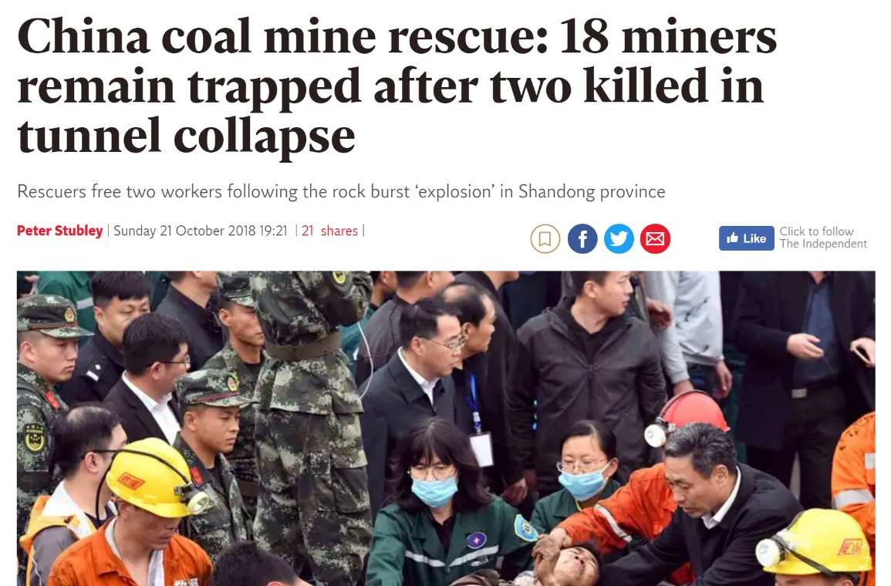
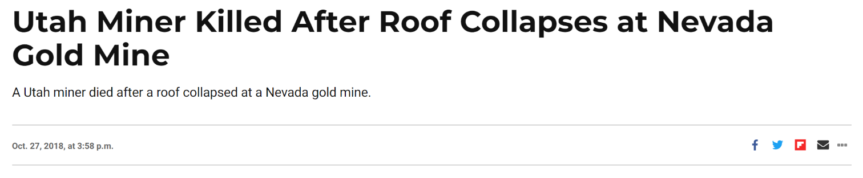
Fall of Ground Prevention
Notes:
Over 40% of all fatalities globally are attributed to fall of ground incidents. We are seeing roof and tunnels collapse not just here in Australia or in the coal sector but across all sectors, and globally these events are becoming more frequent. These are the incidents we are wanting to significantly understand and reduce in the future by providing reliable, accurate, real-time monitoring.

Slide 4
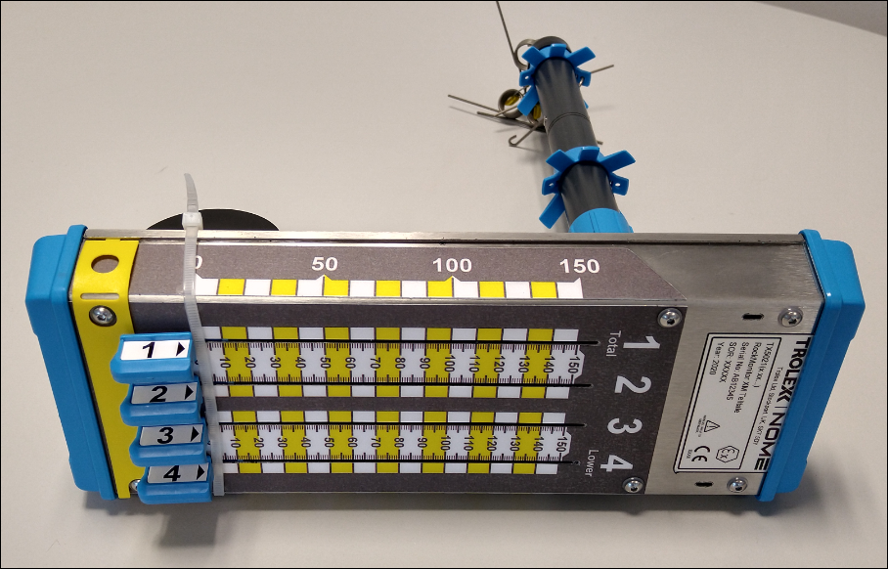
LIMITATIONS OF MANUAL INSPECTION
Whilst mechanical telltales provide a simple low-cost means for visually monitoring strata displacement, manual inspection has a number of limitations:
Time consuming
Limited accuracy
Error prone
Manual data entry required
Delayed data analysis
Difficult to accurately identify trends
Not possible in restricted and inaccessible areas
Notes:
Current methodology is to install mechanical instrumentation to monitor ground support and strata displacement. While this is a low cost solution we have now moved past manual inspections due to limitations such as time consumption, human error and delayed data analysis, leading to strata deteriorating before consolidation can occur.

Slide 5
Cost of Failure
Real time monitoring of critical areas provides early indication of strata movement to prevent a fall of ground event
Remote reading telltales are the safest way to monitor and manage ground conditions
Type | Cost (USD)
Clean up and bolt up | $200,000
Spiles and backfill | $1,000,000
Cost of production loss | $1,000,000/per day
Loss of equipment | $5,000,000
Injury / loss of life | Priceless
Notes:
When these events do occur, there are significant costs, both in remediation and loss of production. These costs can be anywhere from a several hundred thousand, up to millions of dollars per day, along with the priceless expense of an injury or fatality, which we all wish to prevent.

Slide 6
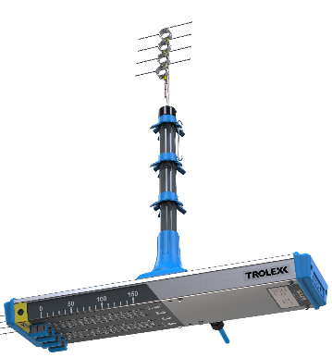
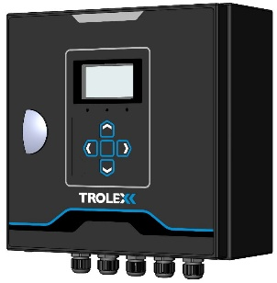
BENEFITS OF REMOTE MONITORING
Enhance Safety
Automated alerts and advanced warnings allow mining operations to take early action, often many hours before the data from manual inspection.
Improve Efficiency
Increase operational up time by reducing the need to shut down for manual inspections. Minimize the need for manual data collection.
Optimise Design
Analyse detailed data to gain insights regarding the effectiveness of roof support strategies. Use accurate information to avoid under or over-bolting.
Reduce Densities
Use continuous accurate real-time monitoring to safely reduce the amount of bolting and standing support required. Significantly reduces incidents/injury through a reduction in manual handling and installation.
Notes:
The benefits of remote monitoring are that we receive early, automated alerts in order to take early action. We also see efficiencies, such as increased production and personal optimisation, by reducing the need for manual inspections and data collection. Analysing this data, also allows end users to optimise their designs and potentially reduce support densities, which in turn reduces manual handling incidents and injuries.

Slide 7








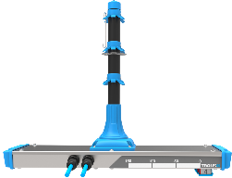
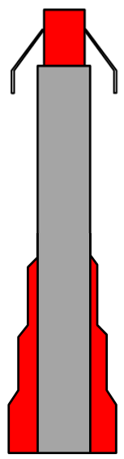
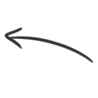

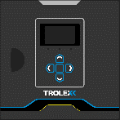

Continuous Remote Monitoring
RMXR Strata Monitoring
Mine monitoring station
Intrinsically safe
Mine-wide remote strata monitoring
Data logging and graphical reporting
Significantly improved operational efficiency and safety
150 units up to 10km range
Plug and Play system - Installed by mine operators
Application software for data analysis. Integrates with SCADA
Configurable alarms
Up to 4 measurement points
Typically 20-50m
intervals
Controller connects to the mine backbone
RockMonitor XR Telltale
Roadway
RockMonitor XR
Controller
^{Leading Safety Technology}
Notes:
Here is an overview of how the system operates underground. Instruments are daisy chained along a roadway at various intervals, running back to a controller with a monitoring range up to a 10km per controller. This data is then sent to a surface server for analysis, alerting and exporting to CITECT or other databases. The system is intrinsically safe so can be installed anywhere in a mine and is now able to be installed by mine personnel, eliminating the requirement and expense of OEM technicians and gathers critical data on both advance and retreat.

Slide 8
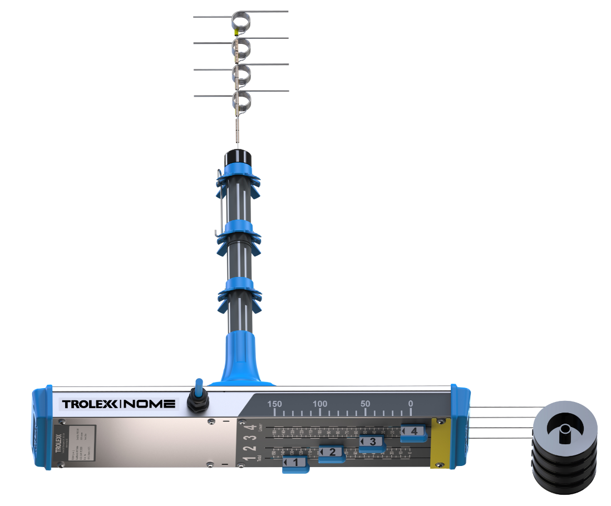
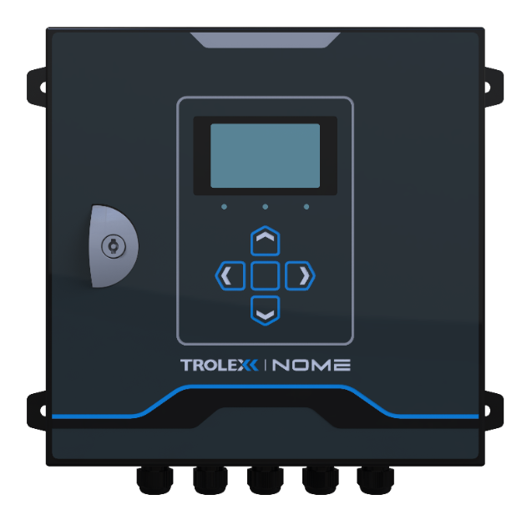
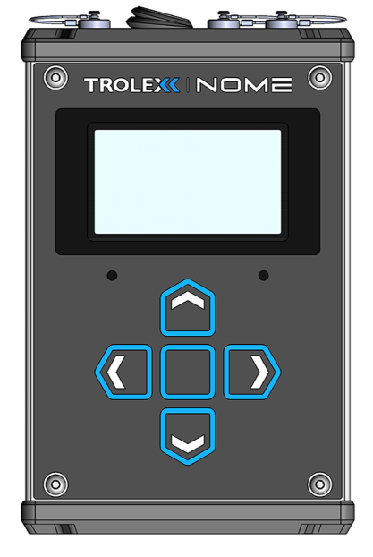
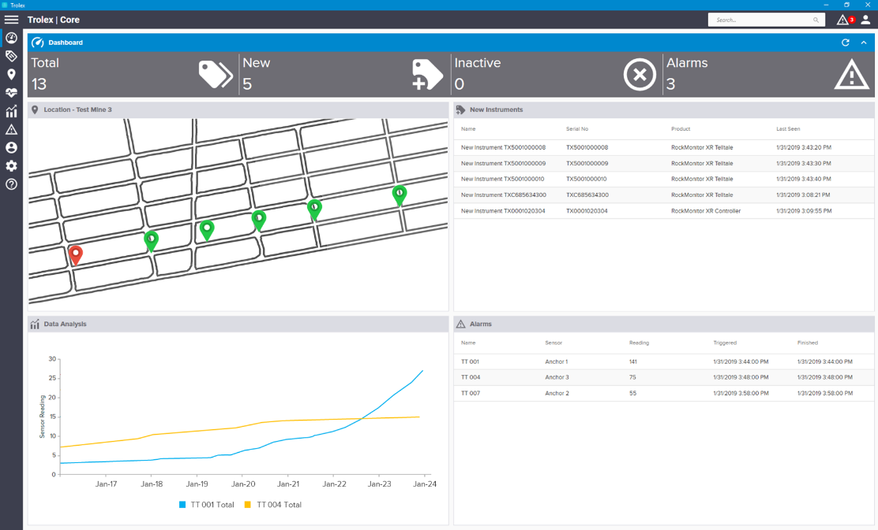
ROCKMONITOR XR SYSTEM
RockMonitor XR Telltale
RockMonitor XR Controller
RockMonitor XR Reader
Core Software
Robust, accurate monitoring of strata displacement with up to four measurement points. Positive tension anchor tabs allowing rapid installation and reset
Collects and stores data from the telltale network and communicates information back to a surface PC or server
Battery powered installation and maintenance tool for quick and reliable system setup. Data logging capability
Easy to use application software with powerful features for alert configuration, data display and system monitoring
Notes:
The system has 4 x main components:

Slide 9

CORE SOFTWARE
Plot telltale positioning on a GIS map for improved safety and monitoring
Get real-time information on system status and strata movement
Fully configurable alarms and automated alerts (mine TARPs)
Notes:
The CORE software displays instruments on a GIS map, colour coded to mine TARP legends. This is where alarms and alerts are customised for each roadway or individual instrument and where data can be analysed and exported as well.

Slide 10
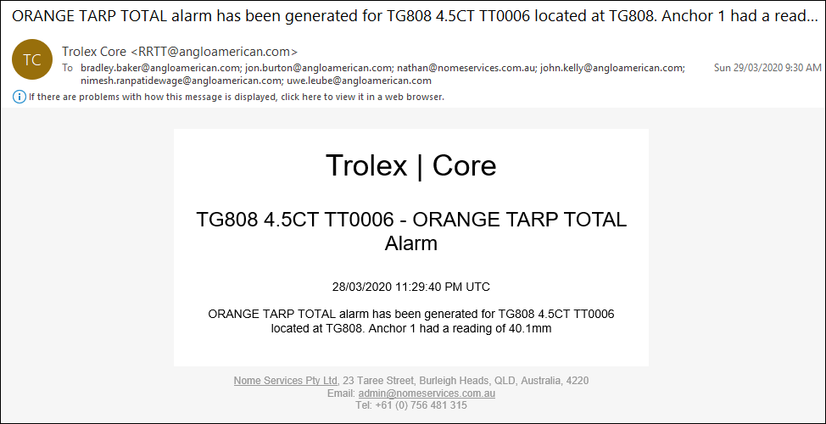

ALARMS & EMAIL ALERTS
Send email alerts and SCADA alarms at configurable trigger levels
Multiple e-mail distribution lists
Only relevant people receive required alerts for their department
CRO can manage alerts via TARP direction
NOME CORE
Notes:
The software sends out both email and SCADA alerts at configurable trigger levels, these alerts can be sent to multiple distribution lists so that only relevant personnel from each department receive the required alerts, reducing unwanted or nuisance alerts. The control room operator also receives alarms via CITECT in real time and can manage these alerts via TARP direction.

Slide 11
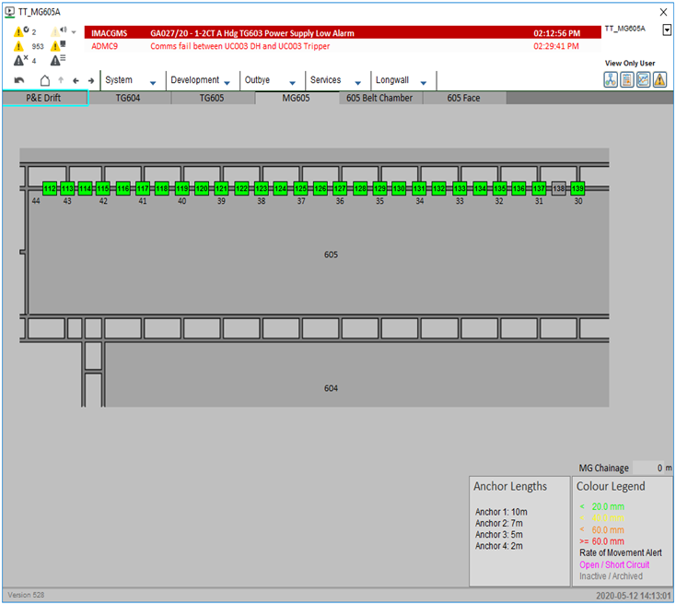
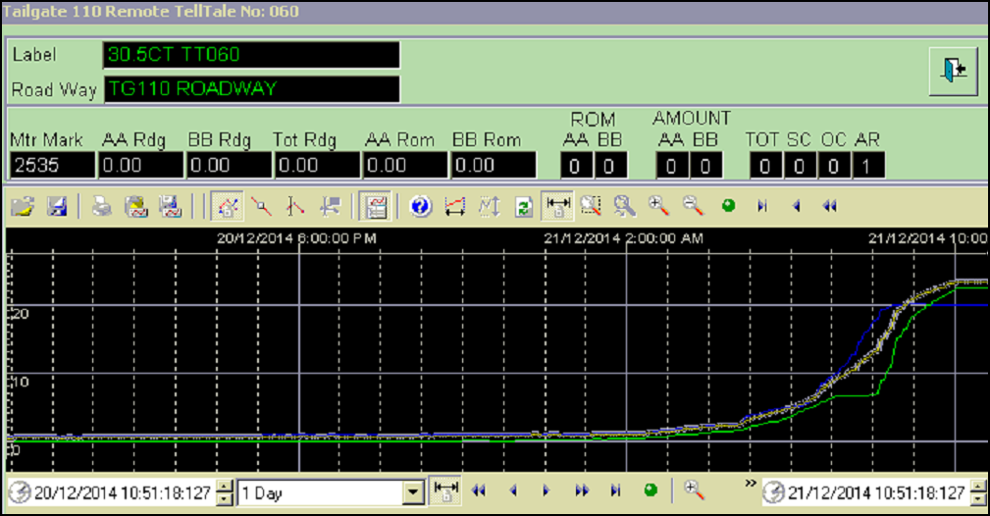
SCADA INTEGRATION
Available on any console running SCADA
Live alerts and historical trending
Is easily integrated with existing manual database software
Ability to tailor reading frequencies and trigger levels to each site/mine area
Notes:
Here is an example of a SCADA or CITECT page. Typically, each roadway will have its own CITECT page, displaying all instruments along the roadway with a legend for easy identification of movement against the roadway TARP. Each instrument can be further interrogated by selecting the instrument, this will bring up a pop-up display, with all readings, chainage and graph over a time period. This time period can be changed from 5 minutes up to several months.

Slide 12
Applications
Drifts/Tunnel Monitoring
Gate-roads
Faceline Monitoring
Life of Mine Roadways
Longwall Operations
Development Operations
Board and Pillar Operations
Civil Projects
There are currently 1000’s of RockMonitor instruments installed in multiple operations across Australia, Africa, USA & Canada.
Notes:
Here is a list of applications for RockMonitor, essentially any roadway or tunnel can be monitored, no matter the sector or type of mining method. There are currently 1000’s of RockMonitor instruments installed in multiple operations across Australia, USA & Canada.

Slide 13
PREDICTING ROOF COLLAPSE
The RockMonitor system has been proven to give advance warning prior to roof collapse
In ALL instances workers were safely evacuated
Automated alarms gave early warning of abnormal movement alerting key staff via e-mail
Continuous, accurate, remote monitoring allowed intelligent decisions to be made
Impact of the unplanned falls were minimised
Longwall
Fault line
Unplanned
roof fall
Cut through
Notes:
Now lets go through a few case studies, here we have a roof fall in a longwall tailgate. In this instance the mine was producing, and the system alerted on very low total movement. However, the rate of movement and distance the instrument was from the face triggered an alert. So, this gave key staff an early warning they otherwise would not have been aware of. The mine had essential equipment in the tailgate, they wished to retrieve and were able to view the data live on SCADA to observe if the rate of movement flattened to access the area. (Next slide)

Slide 14
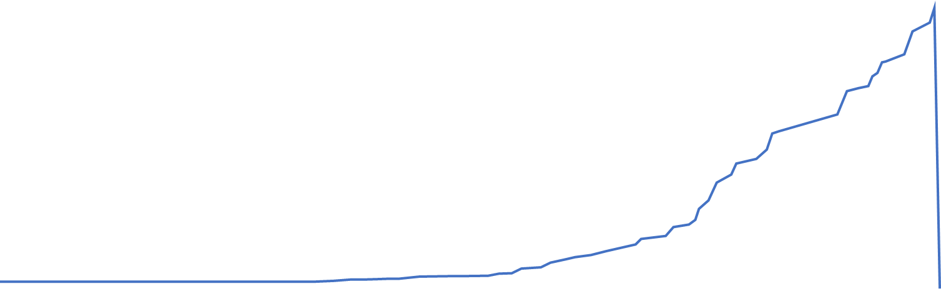
PREDICTING ROOF COLLAPSE
Roof collapses
Final alert triggered
Using mechanical devices checked at 12 hourly intervals could have put workers at serious risk
!
Geotechnical engineers reset alert trigger points
2nd alert triggered
Displacement
Geotechnical engineers reset alert trigger points and continue to monitor data
1st alert triggered
06:00
12:00
18:00
00:00
06:00
12:00
18:00
Notes:
You can see from the above graph that the rate of movement did not reduce, and trigger points continued to be exceeded. The next day following the initial alert, the outbye conveyors stopped longwall production for an extended period, which led to the tailgate roadway falling in. The key point here is, that while the system did not prevent the roof fall occurring, it did provide early warning and the site was able to safely manage the situation without putting personnel at serious risk. This may not have been the case if relying purely on mechanical devices, and infrequent monitoring frequencies.

Slide 15
INDEPENDENT STUDY –
REDUCING EXPOSURE TO HIGH RISK AREAS
The installation of remote monitoring in gate-roads has considerably reduced the requirement for inspections in tailgate roadways – thereby eliminating exposure to personnel
The example below is based on a 3000m longwall block with 3 routine inspections per shift (no maintenance or outbye inspections are included in these numbers)
Notes:
Another case study here is on reduced inspection frequency in longwall tailgate roadways. On this site the inspection regime was 3 x 30 minute inspections per day which halted longwall production and required a deputy to be exposed to high risk areas. With real time monitoring in place the inspection regime was reduced to a single 30 minute inspection every 24 hours. This resulted in a total reduction in exposure for the mineworkers of 60% as well as a production efficiency of 1 hour per day.

Slide 16

INDEPENDENT STUDY –
REDUCED STANDING SUPPORT
Longwall tailgate application
Part of continual drive for ‘zero harm’
100m ‘outbye’ area in tailgate inaccessible ~90% of time
Aim to dramatically reduce the need for standing support
Main gate road
Tail gate road
Leading cause of injury and incident was having to erect support (cribs) to prevent strata control problems
U-shaped ventilation path
Notes:
I mentioned reduced densities as one of the benefits of real time strata monitoring earlier, and here is a case study of when a site increased there standing support distances, from 3mtrs to 6mtr spacings in a longwall tailgate. Prior to this change the leading cause of injury and incident was due to erecting standing support.

Slide 17
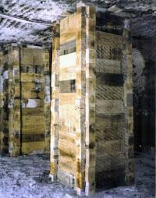
INDEPENDENT STUDY –
REDUCED STANDING SUPPORT
49%
25%
4%
65%
reduction in standing supports through greater spacing (data collection and analysis)
Increase in up-time each maintenance shift
Increase in production rates per week.
Reduction in injury/incident reports
*Link ’n’ Lock wooden cribs
Notes:
By increasing standing support spacing, this site reduced the number of cribs by 49%. Typically, you would associate half the incidents/injuries, if half the workload was removed. However, in this case we saw a 65% reduction. When site investigated this further, it was reported that when the task duration was reduced the workers were less complacent. Meaning they hurt themselves less, which is a great thing to see. With the reduces workload, the maintenance windows were also reduced, which overall resulted in a 4% increase in production per week.

Slide 18
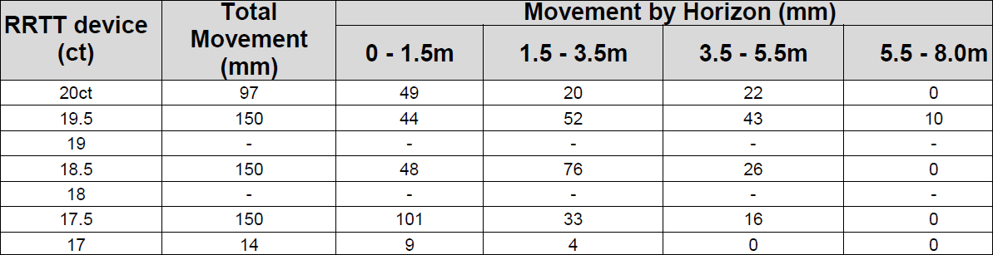
INDEPENDENT STUDY –
OPTIMISE TARP TRIGGERS
Real time data provides geotechnical engineers valuable insight into:
Roof stability in front of longwall face
Effects of changed stress orientation
Effects of coal mine roof rating
Movement by horizon
Acceleration rates
Using this information in combination with total movement in relation to the longwall face position, can be used to establish baseline roof movement behaviour and help develop appropriate TARP triggers.
Notes:
On the graph on the right, you can see telltale total displacement relative to face position. This data is simply not possible to collect manually, as the area is a restricted zone while production is occurring. Therefore, the roof movement behaviour is not as widely known as in other areas of the mine. With real time monitoring, we not only see this total movement relative to face position, but it is also able to distinguish in which horizon movement is occurring. This information can help sites develop appropriate TARP triggers based off actual roof behaviour.

Slide 19
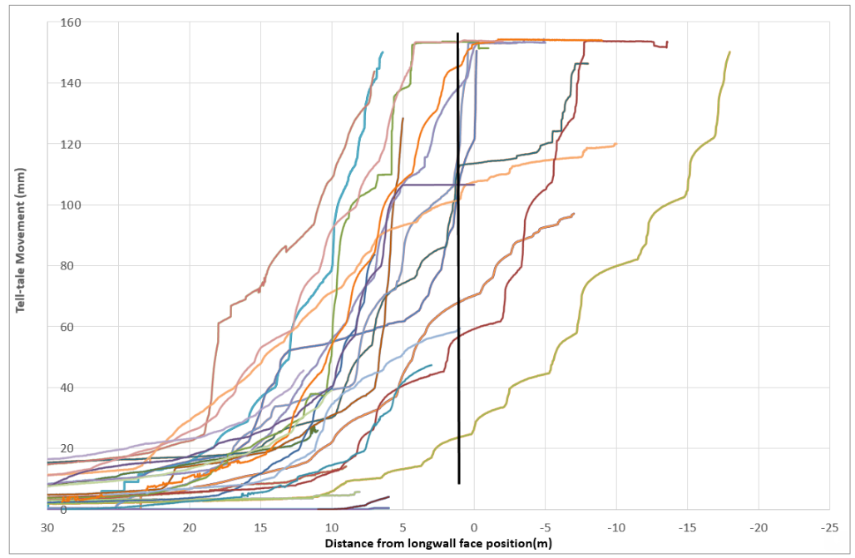
INDEPENDENT STUDY –
ESTABLISHING BASELINE BEHAVIOUR
The case study shown in this slide indicates that there is a change in acceleration rate at approximately 30mm and 80mm.
This continuous feedback loop has been proven to allows sites to optimise their TARP triggers.
When we know what “normal” looks like we can respond effectively and make educated design recommendations for support requirements in the future.
Notes:
As the baseline data set is collected, you can see here that once enough data is collected acceleration rates also become visible. In this instance we see an acceleration rate from 30 mtrs to 12mtrs from the face, then an increase in rate from 12 to 7mtrs and finally another rate change from 7mtrs to intersection. This continuous feedback loop has been proven to allow sites to optimise their TARP triggers and make educated design recommendations in the future.

Slide 20
Summary
Strata Monitoring
Remote monitoring provides significant benefits vs. manual, including a dramatic increase in safety.
RockMonitor have been proven in some of the world’s largest mines.
Instruments now able to be installed directly from continuous miner by operators, as part of standard mining processes.
Efficiency improvements gained through increased production and reduced manual checking can provide significant savings.
^{Leading Safety Technology}
Notes:
Hopefully, these few examples give you an insight into how real time strata monitoring can assist your sites, or clients, and just to recap. (Read 4 x points)

Slide 21
Where To Next?
Strata Monitoring
Continue the Automation Journey!
SMART junction box being designed and certified to allow for automated disconnection and in conjunction with remote operating centres.
University collaboration to incorporate machine learning.
Predictive TARPS for proactive not reactive planning.
Proximity detection included for exclusion of personal from areas when trigger points reached.
^{Leading Safety Technology}
Notes:
While real time strata monitoring is a great step forward, we are not stopping there. We are continuing to innovate and improve to keep up with automation trends. (read 4each point)

Slide 22
THANK YOU
Questions?

